Slide 1
Software Engineering
NEED FOR SOFTWARE ENGINEERING

Slide 2

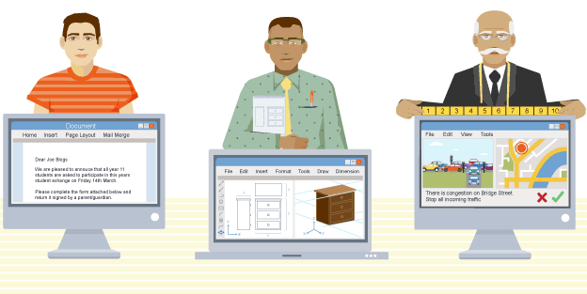
Need for Software Systems
◆ Economies of the world
◆ Industries
◆ Expectations of high reliability
◆ Intangible
◆ Different Types of Software Systems

Slide 3


Professional Software Development
◆ Software engineering is intended to support professional software development, rather than individual programming.
◆ A professionally developed software system is often more than a single program.

Slide 4
Software Engineering - Definition
Software engineering is an engineering discipline that is concerned with
all aspects of software production
from the early stages of system specification through to
maintaining the system after it has gone into use.
Project management - systematic, disciplined, quantifiable approach, Scope & Time & Cost & Quality, Software Tools

Slide 5
Software Engineering Some Basic Considerations
◆ Theories, methods and tools (e.g. prototyping)
◆ Systematic & scientific
◆ Computer assistance
◆ Finding out user’s Formal specification
◆ Error free
◆ Easy to understand
requirements -> Formal/Semi

Slide 6


Software Engineer
◆ Adopt a systematic and organized approach to their work.
◆ Use appropriate tools and techniques depending on the
◆ Problem to be solved
◆ Development constraints
◆ Resources available

Slide 7
Why Software engineering is important?
We need to be able to produce reliable and trustworthy systems economically and quickly.
The majority of costs are the costs of changing the software after it has gone into use.

Slide 8
software failures
Increasing Demands
Low Expectations
Over Budget, Over Schedule, Programming/testing Error

Slide 9
Key challenges facing Software Engineering
Heterogeneity
Delivery - Business and Social Change
Security and Trust

Slide 10
Classic Mistakes
◆ User Expectations Ambiguity
◆ Mythical man-month (n(n − 1) / 2)
◆ Communications - Jargon

Slide 11
Software engineering Vs
Computer Science
System Engineering

Slide 12
Software Is everywhere!
The economies of all developed nations are dependent on software
Software costs often dominate system costs
Software costs more to maintain than to develop!

Slide 13
Definitions: Software
Computer Programs + Associated Documentation
C a n target:
A particular customer: bespoke/customized software
The general market: generic software
Software products are:
Intangible
Complex
Flexible

Slide 14
Definitions: Software Engineering
Action of defining and sequencing necessary tasks for the creation of a new product or service
Software Engineering
Engineering discipline concerned with all aspects of software production
Captures the customers’ business needs and specify the
blueprints for the system, so that programmers can implement it

Slide 15
Definitions: Software Engineering
Software Engineers must:
Adopt a systematic and organized approach to their work
Use appropriate tools and techniques
… depending on:
The problem to be solved
The development constraints
The available resources
... with a given budget
... before a given deadline
... while changes occur!

Slide 16
delivers the required functionality and performance to the user
is maintainable : evolves to meet changing needs
is dependable : must be trust worthy and secure
is usable by its users
is efficient : should not make wasteful use of system resources
is reusable: can be r eused in another form or for other purposes

Slide 17
Skills of a Software Engineer
Software Engineering: An Introduction
A software engineer is not (only) a developer!
“ It is not enough to do your best: you must KNOW what to do, THEN d o your best”
W. Edwards Deming
Aside from the technical skills, a software engineer must have other skills :
Communication
Feedback
Motivation
Analytical
Planning
Risk assessment

Slide 18
Key Challenges
Software Engineering: An Introduction
Need to master both the technical and business problems
Software is formal, while the real world is informal
Coping with legacy systems
Old valuable systems must be maintained, not systematically replaced
Increasing diversity
Consider the set of mixed and heterogeneous hardware and software involved in the same system
Increasing demands for reduced delivery time
Ethical Responsibility!

Slide 19
Key Challenges: Ethical Responsibility
Software Engineering: An Introduction
Behaving in a honest and ethically responsible way I n order to be respected
Respect of the confidentiality of the client’s information
Competence: avoid to misrepresent your competence by accepting a task you can not do
Intellectual Property rights: respect of patents, of copyrights
Computer misuse: the employer’s computer must be properly used
Whether the misuse is trivial (like game playing) or extremely serious (like the dissemination of viruses)

Slide 20




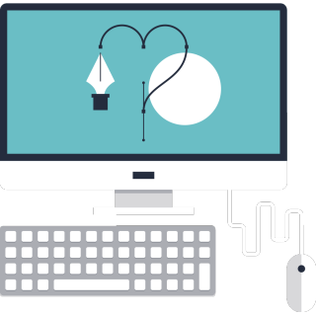


Actors: Mainly (but not only)
Team
Developer
Project Manager
Customer
Designer
Tester

Slide 21
SDLC: Software Development Lifecycle
Requirements Analysis
Release
Design
Testing
Implementation

Slide 22


Step 1 : Requirement Analysis
SDLC: Software Development Lifecycle
Work closely with the customer
Customer can be
R.A.
A client,
your employer,
or yourself
Release
Design
Focus on the “What”, not the “How”
Test
Code
End Result: Functional Specification
Reviewed by:
Customer, Designer

Slide 23
Step 2 : Design
SDLC: Software Development Lifecycle
Focus on the “How”
Break the problem into smaller pieces
Components
R.A.
Release
Design
End Result: Design Specification
Test
Code
Reviewed by:
Designer, Developer

Slide 24
Step 3 : Implementation
SDLC: Software Development Lifecycle
Write the code a ccording to design
In some cases (oddly) the shortest phase!
R.A.
Release
Design
End Result: Executable* Application
Reviewed by:
Designer, Developer, Tester
Test
Code

Slide 25
Step 4 : Testing
SDLC: Software Development Lifecycle
Verify the code works according to the functional specification
R.A.
Look for corner cases
Release
Design
End Result: Test Plan, A program that works *
Test
Code
Reviewed by:
Designer, Developer, Tester

Slide 26
Step 5 : Release
SDLC: Software Development Lifecycle
Close to the customers (again)
Validate their expectations
Get feedback for
R.A.
Release
Design
Next version
Maintenance
Test
Code
End Result: A happy customer and lots of $$$

Slide 27
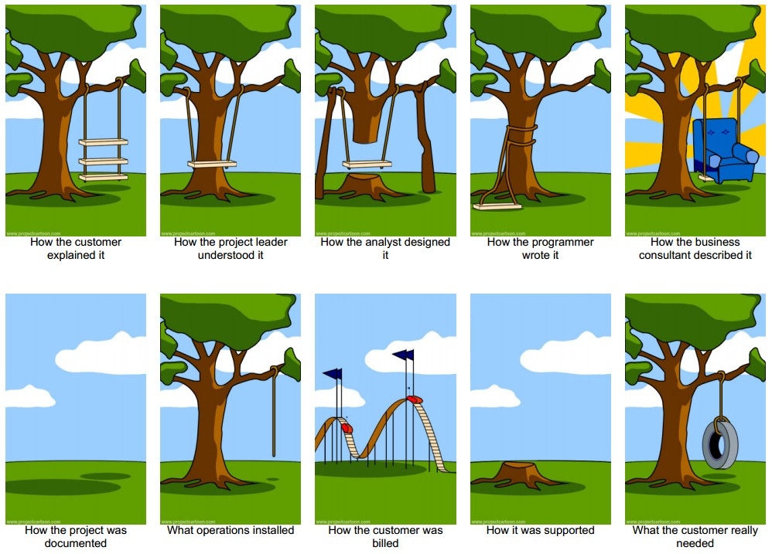
SDLC Challenges
SDLC: Software Development Lifecycle

